Slide 1

Security Assessment and Risk Management
Week 7 –Protection Profiles

Slide 2
Burn the Boats
According to legend, Spanish conquistador Hernán Cortés issued a rather interesting order to his men as they began their conquest of the Aztec empire in 1519.
The order was simple: Burn the boats.
He wanted his men to realize that they had no opportunity to retreat, so they had to give this fight everything they had. Failure was no longer an option and winning this battle just became that much more important.

Slide 3
Making Threats Credible
Thus far we have talked about player in a game making choices to maximize their payoff.
There are reasons why a player might intentionally make choices to limit their options or hamper their payoffs later.
Burning Bridges
Tying Hands

Slide 4

Burning Bridges
Two countries are at war. A river separates them, and in this river is a single island. Each country has a single bridge that they can use to access the island form their side.
Neither side considers the island worth fighting over, but would gladly take it from their enemy if they can.

Slide 5

Burning Bridges
Country one crosses the bridge to occupy the island. Then they must decide to burn the bridge behind them. If they do, they obviously have no escape route.
Country two must then decide to invade. If Country one did not burn their bridge, they then decide to stay or run. If they did, the must fight.
Burn
~Burn
~Challenge
2
2
1, 0
Invade
~Invade
Challenge
1, 0
-1, -1
1
Fight
Retreat
-1, -1
0, 1

Slide 6
Tying Hands
Boss
No Warning
Warning
An boss has become aware that one of his employees has been stealing office supplies. He’d like to find a way to stop the theft without firing the employees.
The boss is considering scaring them off form stealing by issuing a warning to the whole company at the next meeting: Anyon caught stealing will be fired immediately. Question is – should he?
Stop
Quit
1, 0
Employee
Employee
1, 0
Steal
Test
Ignore
Forgive
0, 1
Boss
Boss
-2, 1
Fire
Follow Through
-1, -1
-1, -1

Slide 7
Problems with Committing
You see the flashing red and blue lights while driving through El Paso, TX. The officer walks up and says he’d like to search your car. You can either let him do it quick himself, or you can both wait for the K-9 to show up.
What do you do?
You
K-9
2, 1
Allow
Cop
Quick
Extensive
3, 2
1, 3

Slide 8
Today’s Challenge
Consumers have access to an increasing number of security-enhanced IT products with different capabilities and limitations
Consumers must decide which products provide an appropriate degree of protection for their information systems
Impact: choice of products affects the security of systems in the critical information infrastructure

Slide 9
What is Needed?
Producers of IT products need to have a better understanding of consumer’s information security requirements
Consumers of IT products need to have better ways to:
specify desired security features
assess the security claims made by producers

Slide 10

Common Criteria
Defacto standard for evaluating systems
Globalized merger of the Information Technology Security Evaluation Criteria (ITSEC) and the Trusted Computer System Evaluation Criteria (TCSEC)
Made an official standard by ISO 15408
Evaluation based on 7 Evaluation Assurance Levels (EALs)
Notes:
ISO 15408
MRA-Mutual Recognition Agreement (changed to CCRA “common criteria recognition agreement”)
Any equipment evaluated by one is accepted by all. Items evaluated are placed on the EPL (evaluated product list)

Slide 11
Common Criteria Terminology
Target of Evaluation (TOE): vendor’s product
Protection Profiles (PP): security requirements to be evaluated
Security Targets (ST): vendor’s claims of security (“I will provide”) Security properties of TOE
Security functions requirements (SFR): specify specific functions that may be provided by a product. Components of a protection profile.
Security Assurance Requirement (SAR): description of measures taken during development to assure compliance.
Evaluated Product List (EPL): list of evaluated products
Notes:
Terms:
Target of Evaluation (TOE): vendor’s product
Protection Profiles (PP): security requirements to be specified (“I want”); document identifies security requirements relevant to a purpose (i.e. smartcards to produce digital signatures)
Security Targets (ST): vendor’s claims of security (“I will provide”) Security properties of TOE
Packages: components that can be added or removed from the product
Security functions requirements (SFR): specify specific functions that may be provided by a product.
Security Assurance Requirement (SAR): description of measures taken during development to assure compliance.
Common Evaluation Methodology (CEM): purpose is to:
Eliminate redundant evaluation activities
Reduce/eliminate activities that contribute little to the final assurance of a product
Clarify CEM terminology to reduce misunderstanding
Restructure/refocus the evaluation activities to those areas where security assurance is gained
Add new CEM requirements if needed
Evaluated Product List (EPL):
TOE-evaluated against SFR. Allows for different but similar products to be evaluated by their own capabilities.
Source:
http://www.niap-ccevs.org

Slide 12
Evaluation Assurance Levels
EAL 1 Functionally Tested
EAL 2 Structurally Tested
EAL 3 Methodically tested and checked
EAL 4 Methodically designed, tested, & reviewed
EAL 5 Semiformally designed and tested
EAL 6 Semiformally verified design and tested
EAL 7 Formally verified design and tested
Notes:
Each EAL corresponds to a package of SARs with a given level of strictness
Evaluation Assurance Levels
EAL 1 Functionally Tested (EAL 1 being the most basic (and therefore cheapest to implement and evaluate))
EAL 2 Structurally Tested
EAL 3 Methodically tested and checked
EAL 4 Methodically designed, tested, & reviewed
EAL 5 Semi-formally designed and tested
EAL 6 Semi-formally verified design and tested
EAL 7 Formally verified design and tested (EAL 7 being the most stringent (and most expensive).
EAL 4 is the level corresponding to B1 (secure system)
Levels of evaluation do not guarantee better security
Cheap testing on the low end and expensive on the high end

Slide 13
Introducing NIAP
NIAP is a collaboration between the National Institute of Standards and Technology (NIST) and the National Security Agency (NSA) to meet the security testing needs of information technology (IT) producers and consumers
The long-term goal of NIAP is to increase the level of trust consumers have in their systems and networks through the use of cost-effective testing, evaluation and validation programs

Slide 14
Partnership Objectives
Promote the development and use of evaluated IT products and systems
Champion the development and use of national and international standards for IT security
Foster research and development of IT security requirements, test methods, tools, techniques, and assurance metrics
Support a framework for international recognition and acceptance of IT security evaluation results
Facilitate the development and growth of a commercial IT security testing industry within the U.S.

Slide 15
Program Areas
Security Requirements Definition and Specification
How do we tell product developers what types of IT security we want?
Product and System Security Testing and Evaluation
How do we know if developers produced what we asked for?
Information Assurance Research
How can we improve the ways we achieve assurance in our products and systems?

Slide 16
Activities and Services
Operate Common Criteria Evaluation and Validation Scheme for IT Security
Maintain lists of approved IT security testing laboratories, validated products, and approved test methods
Support the International Mutual Recognition Arrangement for IT security evaluations
Issue Common Criteria certificates for IT products that have been successfully evaluated and validated
Promote government and industry forums for the development of IT security requirements and specifications

Slide 17
Activities and Services
Support information systems security evaluation and assessment programs
Provide state-of-the-art, web based repository of security testing information for IT products and systems
Sponsor technical classes and workshops for IT product developers, testing laboratories, and consumers
Collaborate with industry in the research and development of tools, techniques, and methods for IT security testing
Serve as a general center for expertise and resources for the IT security testing community

Slide 18
NIAP 2000 Projects
Common Criteria Evaluation and Validation Scheme
Cryptographic Module Protection Profile Development
Healthcare Security Forum
Smart Card Security Forum
Telecommunications Security Forum
Common Criteria Tool Box
Automated Security Testing
INFOSEC Assessment Program
Threat and Vulnerability Research
Security in Open Source Software

Slide 19

Defining Requirements
ISO Standard 15408
Protection Profiles
Operating Systems
Database Systems
Firewalls
Smart Cards
Access Control
Identification
Authentication
Audit
Cryptography
A flexible, robust catalogue of IT security requirements
(features and assurances)
Consumer-driven security requirements in specific information technology areas

Slide 20
Industry Responds
Protection Profile
Security Targets
Firewall Product 4
Firewall Product 3
Firewall Product 2
Firewall Product 1
Firewall Security Requirements
Security Features and Assurances
A consumer statement of security requirements to industry
Vendors statements of security claims for their IT products

Slide 21
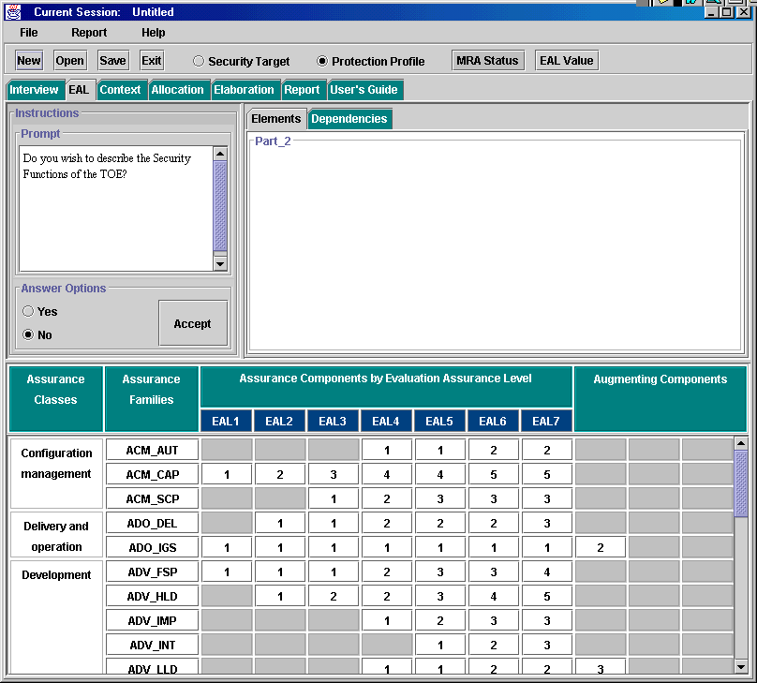
Automated Tools
Helping Consumers
IT Product Security Requirements
Helping Industry
IT Product Security Specifications

Slide 22
Demonstrating Conformance
Private sector, accredited security testing laboratories conduct evaluations
IT Products
Common Criteria Testing Labs
Test Report
Vendors bring IT products to independent, impartial testing facilities for security evaluation
Test results validated by NIAP and CC certificate issued

Slide 23
Mutual Recognition
NIAP, in conjunction with the U.S. State Department,
negotiated a Common Criteria Mutual Recognition
Arrangement that:
Provides recognition of U.S. issued certificates by Canada, the United Kingdom, France, Germany, Australia, and New Zealand
Eliminates need for security evaluations in more than one country and provides excellent global market opportunities for U.S. IT product vendors

Slide 24
NIAP Testing Advantages
Specification of security features and assurances based on an International Standard
Evaluation methodology based on an International Standard---leading to comparability of test results
Testing laboratory expertise assessed by NIST’s National Voluntary Laboratory Accreditation Program---an internationally recognized program based on international standards
Quality technical oversight provided by NIST/NSA experts
Evaluation results recognized by many nations

Slide 25
Education and Training
Common Criteria Protection Profile Development Classes
Common Evaluation Methodology Familiarization Classes
Common Criteria Evaluation and Validation Technical Workshops
Information Assurance Workshops

Slide 26
Summary
NIAP is helping secure the critical information
infrastructure (public and private sectors) by:
Promoting the development of a commercial security testing industry in U.S.
Increasing the security of IT systems through wider availability of evaluated products
Providing product developers with an opportunity to sell evaluated products in world-wide markets

